Slide 1


Globalisation
in
India
(Political Science Pesentation)

Slide 2

Introduction to Globalisation
Globalisation refers to the interconnectedness and interdependence of nations on a global scale. This interconnectedness is driven by factors like trade, technology, and cultural exchange.
In the context of India, globalisation has been marked by its gradual integration into the global economy, leading to significant economic growth and social transformation.

Slide 3

Theories and Concepts - Liberal and Realist
Liberal
Realist
Liberals view globalisation as a positive force that promotes economic growth, reduces poverty, and spreads democracy. They believe free trade and open markets lead to greater prosperity.
Realists, on the other hand, argue that globalisation is a process driven by powerful states, often at the expense of weaker ones. They emphasize the role of national interests and security.

Slide 4
NEP 1991
1
Liberalization
Reduced government control over industries and trade.
2
Privatization
Encouraging private sector participation in various sectors.
Globalization
3
Opening up the Indian economy to foreign investment and trade.

Slide 5

Process of Globalisation
1
Trade liberalization: Reducing trade barriers and promoting free trade.
Capital flows: Increased investment and financial integration across borders.
2
Technology diffusion: Rapid spread of new technologies, like the internet, and communication networks.
3
Cultural exchange: Growing interconnectedness of cultures through media, tourism, and migration.
4

Slide 6
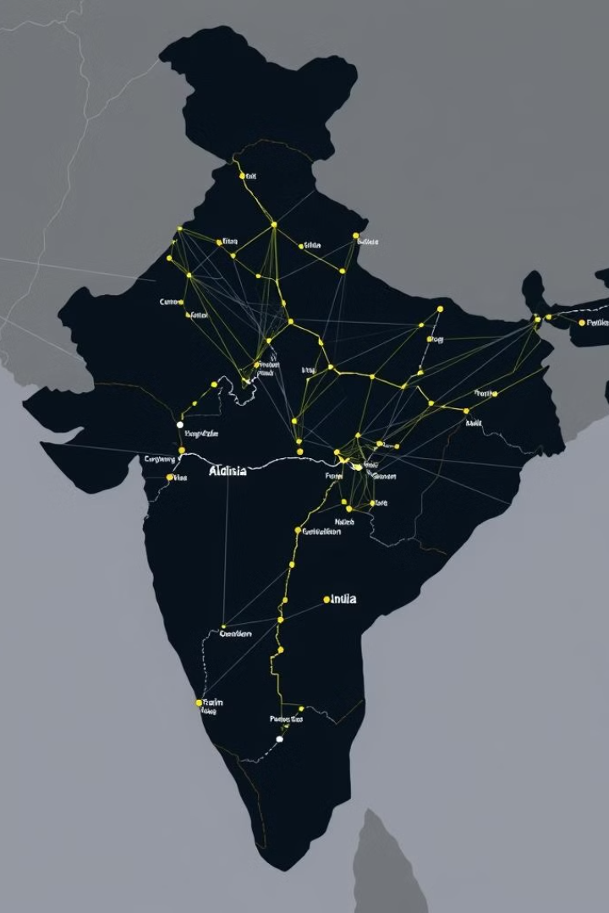
Political Consequences
1
Increased influence of international organizations.
2
Growing interdependence and diplomacy.
Globalisation has led to a greater role for institutions like the WTO and IMF in shaping India's economic policies.
India has fostered closer diplomatic relationships with other countries as it engages in global trade and partnerships.
3
Debates on sovereignty and autonomy.
Globalisation has sparked debates on how to balance national interests with the need for international cooperation.

Slide 7





Economic Consequences
Economic Growth
Trade Expansion
Globalisation has led to substantial economic growth in India, particularly in sectors like IT and outsourcing.
India's trade with other countries has expanded significantly, with increased exports and imports.
Foreign Direct Investment
Employment Opportunities
India has attracted substantial foreign direct investment, bolstering its infrastructure and industrial development.
Globalisation has created new employment opportunities, especially in service sectors.

Slide 8

Cultural Consequences

Slide 9



Westernization
1
Exposure to Western culture through media and consumerism.
Cultural Blending
2
Fusion of Indian and global cultural elements, creating a unique hybrid culture.
Increased Cosmopolitanism
3
Greater cultural awareness and understanding among Indian citizens.

Slide 10



WTO
The World Trade Organization (WTO) is the only global international organization dealing with the rules of trade between nations. At its heart are the WTO agreements, negotiated and signed by the bulk of the world’s trading nations and ratified in their parliaments. The goal is to ensure that trade flows as smoothly, predictably and freely as possible.
164
13
Members
Rounds
India is a member of the WTO, committed to upholding international trade rules.
India has actively participated in WTO negotiations, shaping trade agreements.

Slide 11

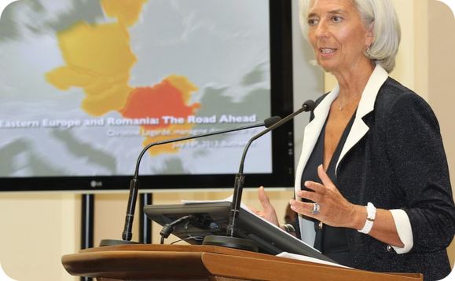

IMF
The IMF is a global organization that works to achieve sustainable growth and prosperity for all of its 191 member countries. It does so by supporting economic policies that promote financial stability and monetary cooperation, which are essential to increase productivity, job creation, and economic well-being. The IMF is governed by and accountable to its member countries.
Financial Assistance
Economic Advice
India has received financial assistance from the IMF during periods of economic hardship.
India has benefited from the IMF's technical expertise in areas of fiscal policy and economic reforms.

Slide 12
Globalisation and Technology: A Catalyst for Growth
Digital Revolution
Innovation Hub
Globalisation has ushered in a digital revolution in India, connecting people and businesses through the internet and mobile technology. This has fueled the growth of various sectors, from e-commerce to fintech, and led to increased access to information and services.
India has become a global innovation hub, attracting investments and collaborations in areas like IT, pharmaceuticals, and biotechnology. Globalisation has fostered a spirit of entrepreneurship and encouraged the development of new technologies and solutions.

Slide 13
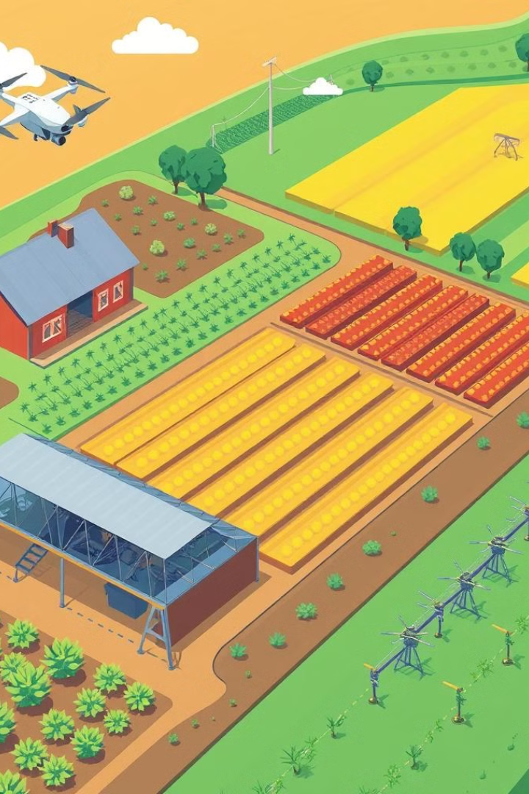


Globalisation and Agriculture: Modernising the Food System
Need for less manpower
Globalisation has led to the need for lesser manpower creating loss of jobs in agriculture due to increased technologies.
Abandonment of traditional practices of Farming
While India has seen technological advancements globalisation has also led to the abandonment of traditional farming methods and the HYV seed and fertillizers has also led to the degeradation of soil quality and heavy dependance on rainfall.

Slide 14
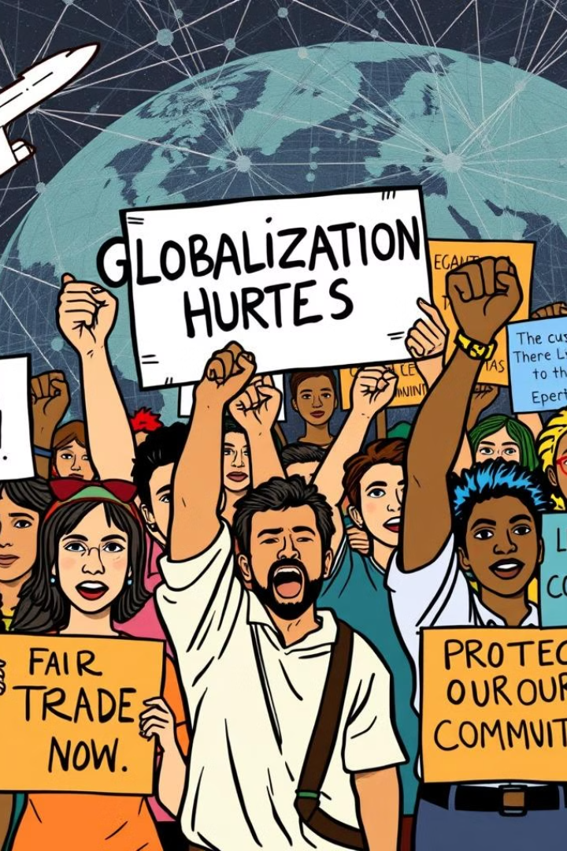
Anti-Globalisation
Job Losses
Cultural Erosion
One of the key concerns is job losses in certain sectors due to competition from foreign companies. This can lead to unemployment and economic hardship for workers in affected industries.
Critics argue that globalisation can lead to the erosion of local cultures and traditions, as Western influences become more dominant. This can raise concerns about the preservation of cultural identity.

Slide 15



Impact on Governance: Adapting to Globalisation
Policy Reforms
1
Globalisation has necessitated policy reforms to attract foreign investment, promote trade, and ensure competitiveness in the global market.
Trade Agreements
2
India has entered into various trade agreements with other countries, leading to the liberalization of trade and the removal of barriers to global commerce.
Regulatory Changes
3
Governments have implemented regulatory changes to address the challenges and opportunities presented by globalisation, aiming to create a conducive environment for growth and development.

Slide 16




Challenges
Income Inequality
Globalisation has led to increased income inequality, as some sectors and individuals have benefited more than others. This has created social and economic disparities, requiring measures to address the gap.
Environmental Concerns
Globalisation has accelerated industrialization and urbanization, raising concerns about environmental degradation and climate change. Sustainable development strategies are crucial to mitigate these impacts.
Trade Imbalances
Trade imbalances can arise from globalisation, with some countries having a surplus while others face deficits. Balancing trade and promoting fair competition is crucial for global economic stability.

Slide 17
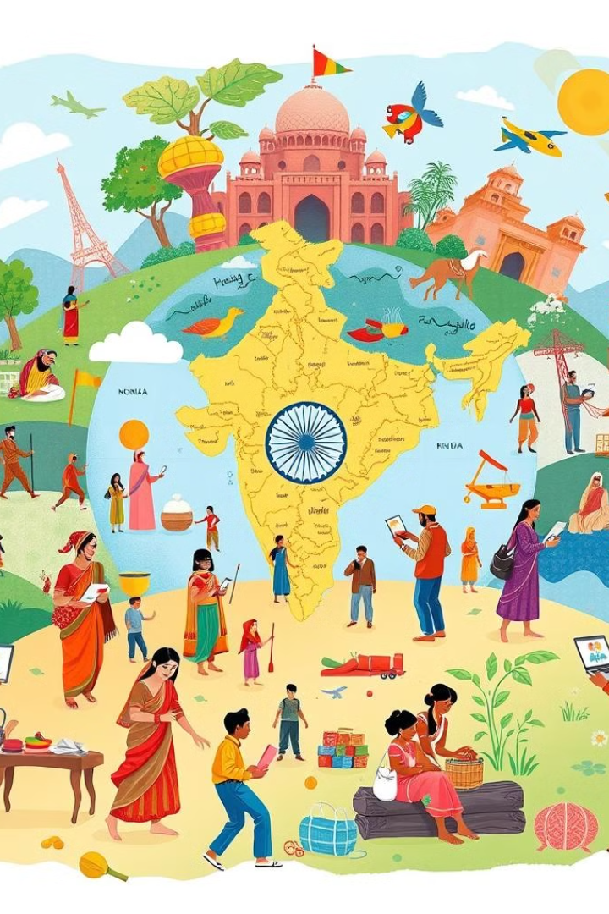
Conclusion
Globalisation has brought both opportunities and challenges to India. The country has successfully leveraged globalisation to fuel economic growth, technological advancements, and social progress. By addressing the challenges, India can navigate the complexities of globalisation and continue its journey towards sustainable and inclusive development.
Thank You!!

